Slide 1
Research Collaborator Recommendation using Hybrid Recommender System in Science Gateways through Conversational Agent
Sai Swathi Sivarathri
Adviser : Prof. Prasad Calyam
University of Missouri, Columbia

Slide 2
Agenda
Science Gateway Introduction
Research Community Growth Problem Formulation
Our Proposed Solution

Slide 3
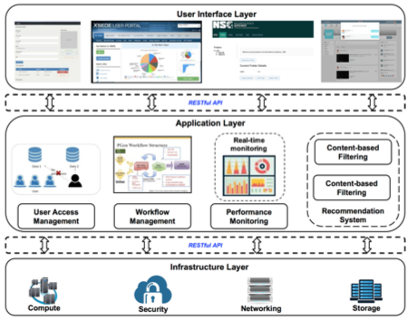
Helping Domain Sciences use Cyberinfrastructure
Science gateway (SG) is an online community space for science and engineering research and education
SGs allow access to shared data, software, computing services, instruments, educational materials, and other resources specific to their disciplines

Slide 4
Problem Formulation: Researcher Community Growth
The existing SGs do not foster the re-use of knowledge of prior users as part of the resource composition of future users
Growth in research can be accelerated by recommending potential collaborators as a resource to researchers
Considering the enormous user base in SG, finding individual with common research interest is difficult task without an expert
There are many recommendation systems for collaboration discovery but there is scarce use of them in SGs

Slide 5



Proposed Solution: Hybrid Recommendation System
Vidura Chatbot
We propose a novel Collaborator Recommendation System to recommend collaborators in Neuroscience Gateways using a conversational agent
We developed 'Vidura' chatbot based on Google's Dialogflow
User
Hybrid Recommender System
Chat Server
Content based Filtering
Collaborative Filtering
Demographic Filtering
Knowledge based Filtering
Research Interest
Education
User Preferences
Skills
Location
Source Data

Slide 6


contd..
Data for our system is collected using chatbot
Hybrid approach is used for recommendation system which is a combination of collaborative, content-based, demographic and knowledge based filtering
Our recommender system helps users in building and maintaining strong research teams
Research Interest
Education
Occupation
Skills
Similar Features
User with similar features as target user is recommended
Target User

Slide 7
Thank You !
Questions ?

